Slide 1
NBA Data Analysis
John Roberts

Slide 2

Purpose
NOTE:
To change images on this slide, select a picture and delete it. Then click the Insert Picture icon
in the placeholder to insert your own image.
The purpose of this analysis is to build a model that can somewhat accurately build a model to predict player performance given an opponent, venue, and a player's starting status.

Slide 3
Data
Acquired Data Sets from BigDataBall.com https://www.bigdataball.com/
Team Box Scores – 2019 – 2022
Player Box Scores – 2019 – 2022
NBA DFS Data – 2019 - 2022
Acquired Aggregated Data Sets from Basketball-Reference.com https://www.basketball-reference.com/
Team Per Game Stats – 2019 – 2022
Team Advanced Stats – 2019 – 2022
Vs. Team Stats – 2019 – 2022
Player Per Game Stats – 2019 – 2022
Player per 100 Poss Stats – 2019 – 2022
Player Advanced Stats – 2019 – 2022
Player Adjusted Shooting – 2019 - 2022

Slide 4

Combined Data
Combined all data into Microsoft SQL Server using SQL’s import and Export Data Application.
Created numerous queries to generate a flat file that contains all stats by player on a per game basis.

Slide 5
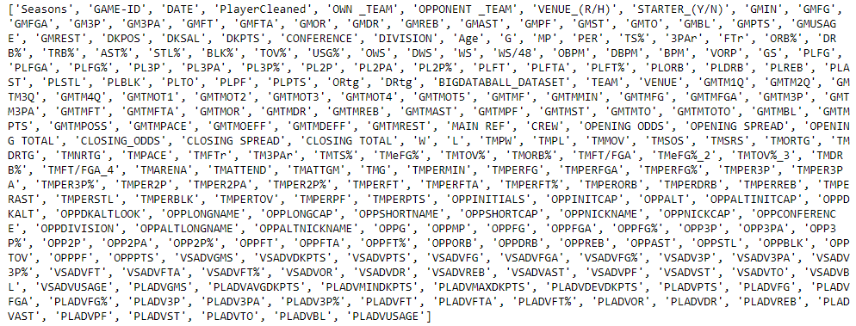
Jupyter Notebook
Pulled the combined flat file into jupyter notebook and created a NBA Data Frame. The data frame has all the following columns:

Slide 6
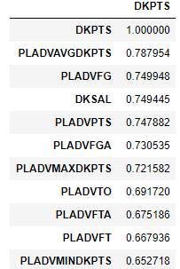
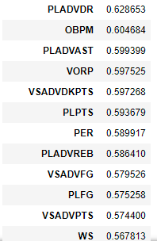
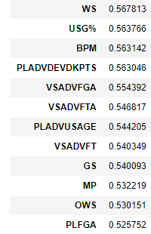

Correlation
Did a simple correlation analysis to see which fields were the best predictor of DKPTS. Using DKPTS as a target variable as it uses all box score variables to create a composite score (Points, Rebounds, Assists, Steals, Blocks, 3pt Makes, Turnovers, Double Double and Triple Double Statistics)

Slide 7
Linear Regression Modeling
Created 4 models using linear regression
Model 1 – I used all the columns that had greater than a .50 correlation to the target.
R-Squared .628
The most significant variable was a players average dkpts .6975
There were some interesting relationships that will need further exploration (all of the actual scoring averages had a negative relationship to the score (Avg FG, Avg FGA, Avg FT, Avg Pts)
Model 2 – I used all of the columns that had a greater than a .50 correlation to the target and the variables from model 1 that had a p score of 0
R-Squared .627
The most significant variable was average dkpts .7763
Scoring averages continue to have a negative relationship to score

Slide 8
Linear Regression Modeling Cont.
Model 3 – Used the same variables from model 2 but included the categorical variable for a player's position
R-squared .628
The position variables had some of the largest coefficients of the model
All the coefficients from model 2 stayed relatively flat
Model 4 – Used all the variables from model 3 but also included a player's own team, the opponent team, the venue and a players starting status (all categorical values)
R-squared .631
While the coefficients of a player's team and opponent had some impact, the largest impact was a player's starting status.

Slide 9
Random Forest Regressor
Created a Random Forest Regressor model using the same data cleaning from the regression models.
Used all available columns as features for this model
Created a test set of data (25% of all the data) and used a random_state of 42 so that the tests could be accurately repeated
1000 decision tree model
Mean Absolute Error: 7.38
The players average DKPts was by far the most important feature .62 no other feature was larger that .02

Slide 10
Random Forest Regressor cont.
Scored the test set of variables and exported the results as a CSV
Model Results
26% the model was within 3 pts of the actual score
43% the model was within 5 pts of the actual score
57% the model was within 7 pts of the actual score
73% the model was within 10 pts of the actual score

Slide 11
Alteryx Assisted Modeling Random Forest
Alteryx is an American computer software company based in Irvine, California, with a development center in Broomfield, Colorado. The company's products are used for data science and analytics. The software is designed to make advanced analytics accessible to any data worker.
Using the Alteryx designer, I was able to create an assisted data model using the same data from the previous models.
I created two models using the tool one with all the features that were used in the Random Forest Regressor model and one using all of the default suggestions from the assisted modeler

Slide 12
Alteryx Assisted Modeling Random Forest cont.
Model 1 used all the available feature fields
The modeler replaced all null numeric values with the median values for numeric values and with a constant value for the categorical values
Player average DKpts continues to be the most important variable
Mean Absolute Error of 7.02
Model shows a correlation of .79
Model Results
29% the model was within 3 pts of the actual score
46% the model was within 5 pts of the actual score
61% the model was within 7 pts of the actual score
77% the model was within 10 pts of the actual score

Slide 13
Alteryx Assisted Modeling Random Forest cont.
Model 2 used only fields recommended by modeler based off GINI scores
The modeler replaced all null numeric values with the median values for numeric values and with a constant value for the categorical values
Player average DKpts was not used in the model and Average FGA became the most important feature
Mean Absolute Error of 7.15
Model shows a correlation of .79
Model Results
29% the model was within 3 pts of the actual score
46% the model was within 5 pts of the actual score
61% the model was within 7 pts of the actual score
77% the model was within 10 pts of the actual score

Slide 14
Conclusions
Because of the collinearity and the presence of a good number of categorical variables, decision trees are the better choice to model the data.
Manually created decision tree is comparable to both assisted modeling models in predicting DKpts.
In general, the model will predict within 10 points of the actual score 70% of the time.

Slide 15
Next Steps
I would like to understand more about the relationship of some of the features it seems unintuitive to me that a stat like avg fg and avg fga would have a negative impact on the score.
I would like to export the results into a tableau workbook in a way that a user could select a team, a position, an opponent, and a venue and have tableau show a potential range of outcomes.
I would like to expand the model to a full box score and try to predict, points, FG, FT, REB, BLK, STL, Ast, and Turnovers and possibly be able to simulate a game or a season.
All resources can be located: https://github.com/john10roberts/WakeTechCapstone

